Slide 1
Programming Made Easy
Bartek Wasielak

Slide 2




About me
Bartek Wasielak
@bwasielak

Slide 3
Agenda
Programming in general
Different techs and languages
Programming for the Web
Introduction to OOP
Hands On Lab

Slide 4
Programming in general

Slide 5
What can we achieve?
Build application no-one’s built
Modify existing app’s behaviour
Consume any data
Make your life easier
Fun!
Notes:
An application for my wife for time tracking – there was no simple free time tracking app

Slide 6
Different kind of applications
Desktop applications
Web applications
Mobile applications
Embedded applications
Notes:
Desktop apps are usually specific for a particular platform (operating system). Sometimes they can be OS agnostic. Usually not so robust as native ones.
Explain what native means.
Web application – works on a server side, presented to a user by a browser. Usually OS and browser agnostic. Sometimes use technology that requires specific OS/browser. Example: Flash doesn’t work on iOS. Silverlight has no official and current implementation for Linux (works on Windows and Mac only)
Embedded applications – robotic rovers, washing machines, home a

Slide 7
Technologies and languages

Slide 8
What does a computer do?
Computer programs are text documents
Programs are executed by a processor (CPU)
CPU doesn’t execute text

Slide 9
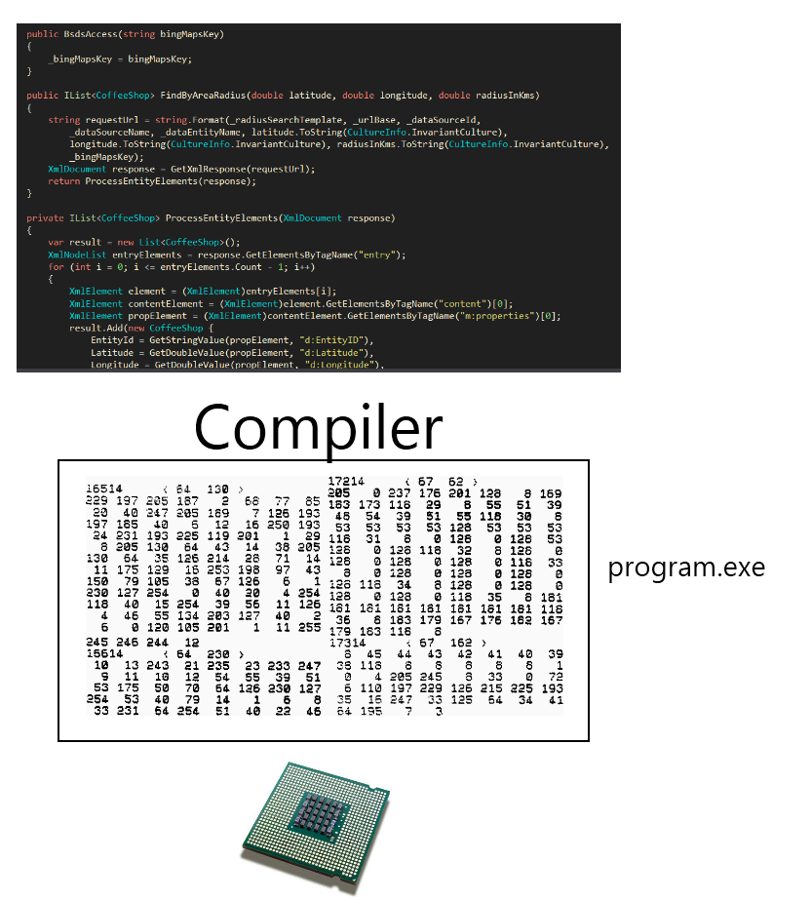
Compiling

Slide 10
Compiling
Maximum robustness
Need to compile against every CPU

Slide 11
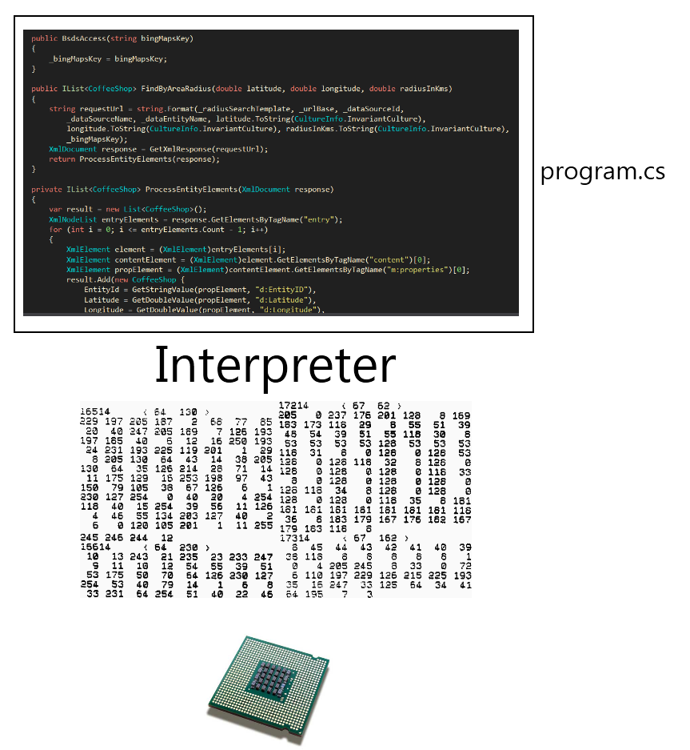
Interpretation

Slide 12
Interpretation
Poor efficiency
Need to have an interpreter for every OS/CPU
Everyone can see the code
No need to recompile
Notes:
Often used in the Web

Slide 13
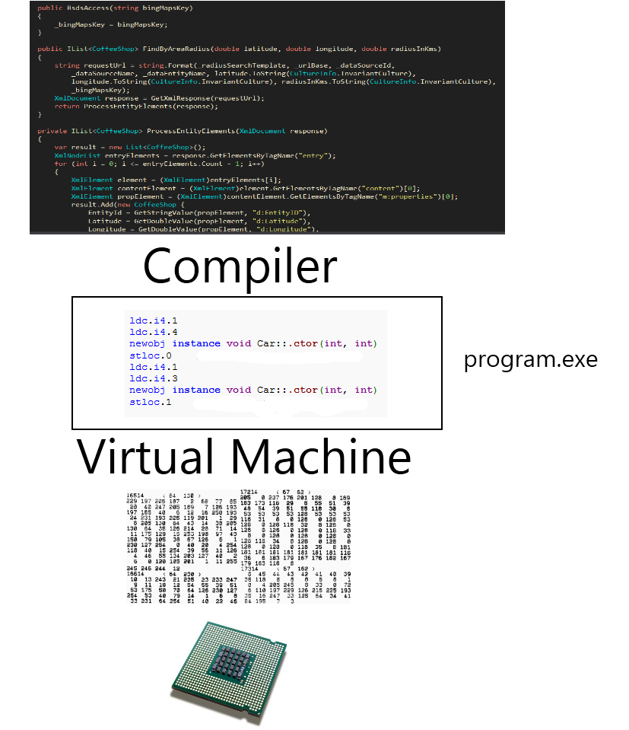
Virtual machine

Slide 14
Virtual machine
Medium efficiency
Compile once – to bytecode
Need to have a VM for every OS/CPU

Slide 15
The web - Web request
User types an address in a browser
The browser contacts a right server
The server recognizes the request
The server finds a program bound to the address
The program executes and returns an HTML document
The browser downloads the document
The browser executes all the code attached to the documents

Slide 16
Object Oriented Programming
Programming paradigm
Using objects
Each object is an instance of a class
Each class has fields and methods
Notes:
Objects – encapsulate state and expose behaviour

Slide 17


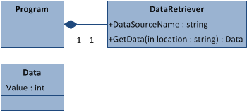
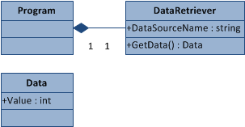
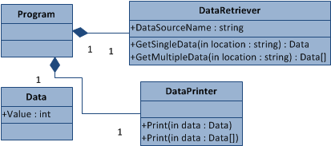
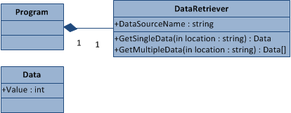
Object Oriented Programming

Slide 18
Let’s get our hands dirty!

Slide 19
Establish a project
Login to coderun.com

Slide 20



Architecture

Slide 21
Task 0 – run an empty project
Compile
Run
Verify

Slide 22
Task 0.1 – change a header
Open HomeController
Change text in Index method
Compile
Run
Verify

Slide 23
Task 0.2 – prepare a text control
Open Index.cshtml
Add @ViewBag.Text
Open HomeController
Find Index method
Assign some text to ViewBag.Text
Compile, run, verify

Slide 24
Task 0.3 – prepare a text control cont’d
Surround @ViewBag.Text with a <div> with an id
Open Content/themes/
Site.css
Add a border to div’s id (#customText)

Slide 25

Task 1 – Display a record
Modify Index method
Create an instance of BsdsAccess
Call GetCoffeeShopById method
Display this shop’s DisplayName

Slide 26
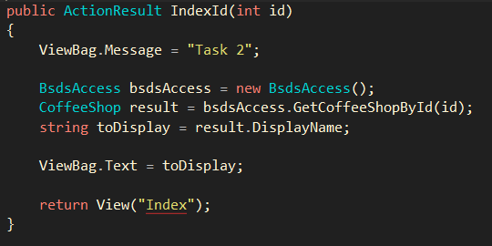
Task 2 – Display a record of a given id
Copy entire Index method
Rename it IndexId
Add a parameter of type int
Change return: View("Index")
Use a parameter

Slide 27
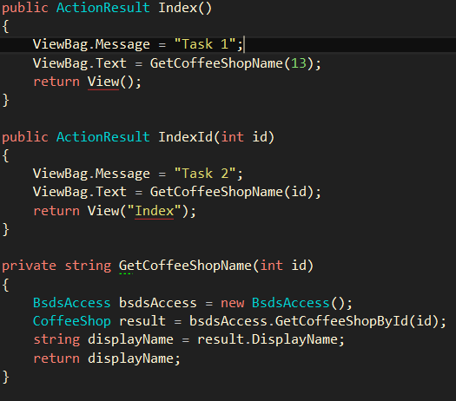
Task 2.1 – Extract a method
First refactoring!
Create new method
Add a parameter of type int
Copy three common lines
Add a return statement
Use your new method!

Slide 28
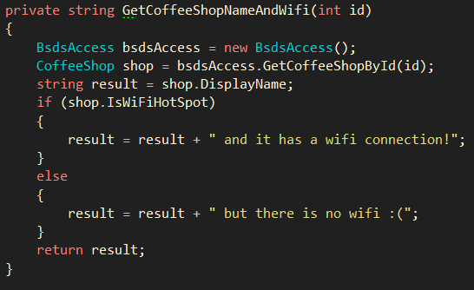
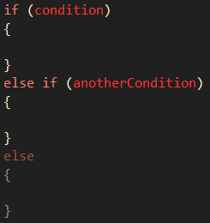
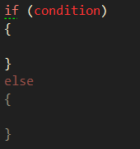
Task 3 – displaying more data
Write another helper method
Check if there is a wifi connection
Write another controller action
Wire it up
Notes:
15 no wifi
16 wifi

Slide 29
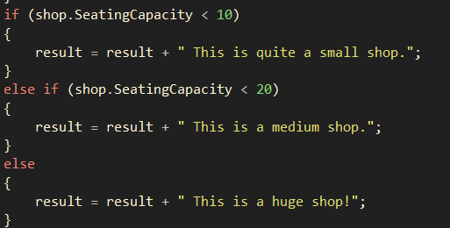
Task 3.1 – add more conditions!
Check SeatingCapacity
Small (<10), medium (10-20), big (>20)
Notes:
#10 big (20)

Slide 30

Task 3.2 – Join conditions
Looking for a big shop accepting coffee cards
&& - means AND
|| - means OR
Try other conditions
For string
PrimaryCity == „Miami”
Notes:
10003 – 25, true
10129 – 25, false
15 – Miami
250 – Weston

Slide 31
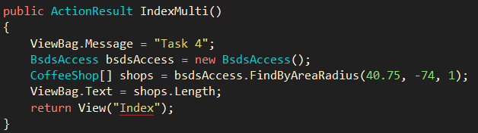
Task 4 – Read multiple records
Create another controller action
Search for NY: φ=40.75, λ=-74
r=1 [km]
Print a number of shops
Use array’s method Length

Slide 32
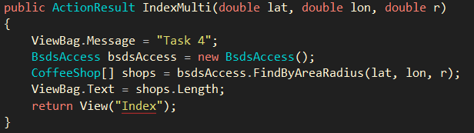
Task 4.1 – Involve a user
Modify your controller action
Enable taking parameters from users
Add parameters to the method
Call it with .../IndexMulti/?lat=...
&lon=...&r=...

Slide 33
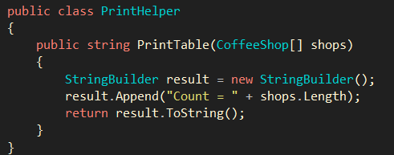

Task 4.2 – Prepare to print all the records
Add a new folder: Helpers
Create a new class: PrinterHelper
Use StringBuilder
Move counting logic there

Slide 34

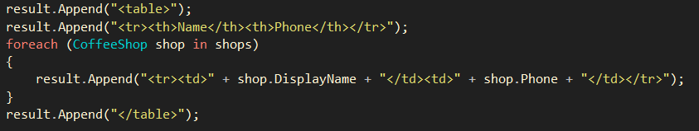
Task 4.3 – Print all the records
Change in the view: @Html.Raw(ViewBag.Text)
Iterate through the shops
Foreach – goes through every member of a collection
Construct HTML’s table
Use <table>, <tr>, <th> and <td>

Slide 35
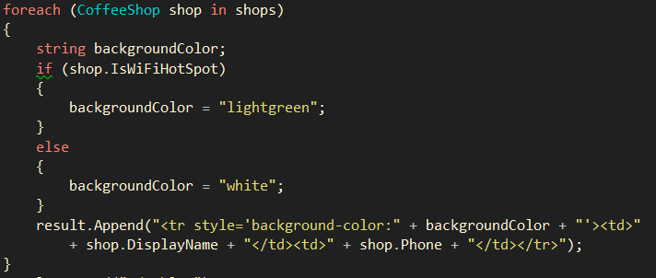
Task 4.4 – Add conditional formatting
Check if wifi is available
Set background colour for rows

Slide 36
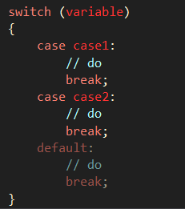
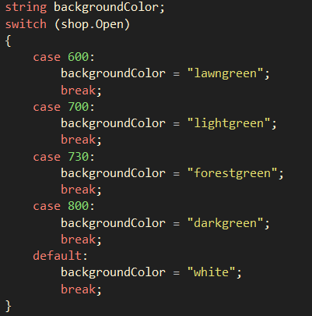
Task 4.5 – More conditional formatting – switch
Set colour based on shop’s opening time
Switch replaces multiple if’s with condition on the same variable

Slide 37
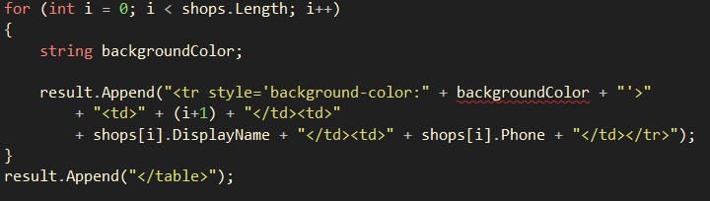

Task 5 – Play with collections
Display shop’s # on the page
Need to use for instead of foreach

Slide 38
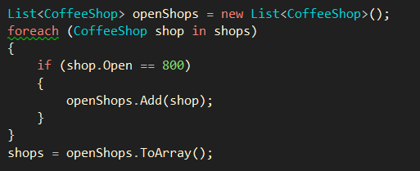

Task 5.1 – Display only some shops
Display shops opening at 8am only
Need to pass a smaller collection
First – use arrays

